Slide 1

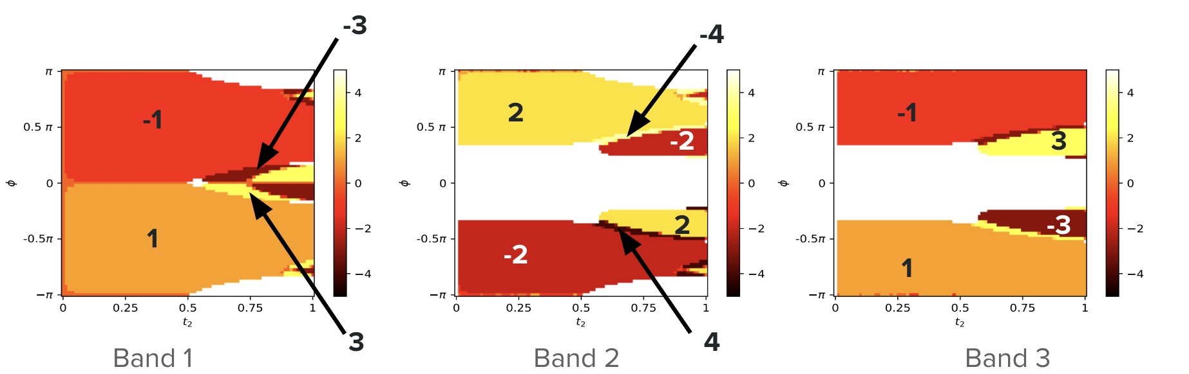
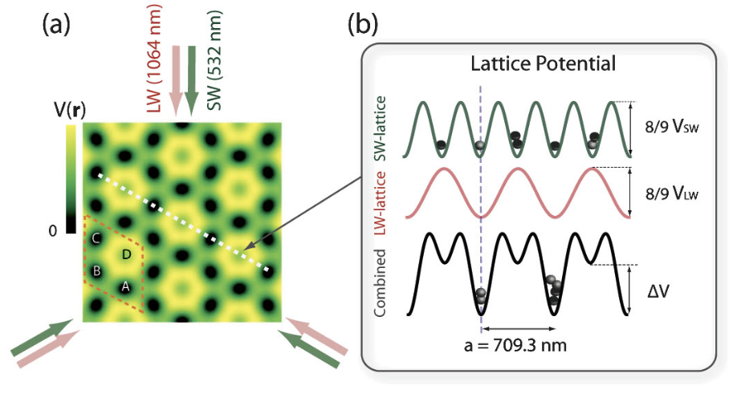
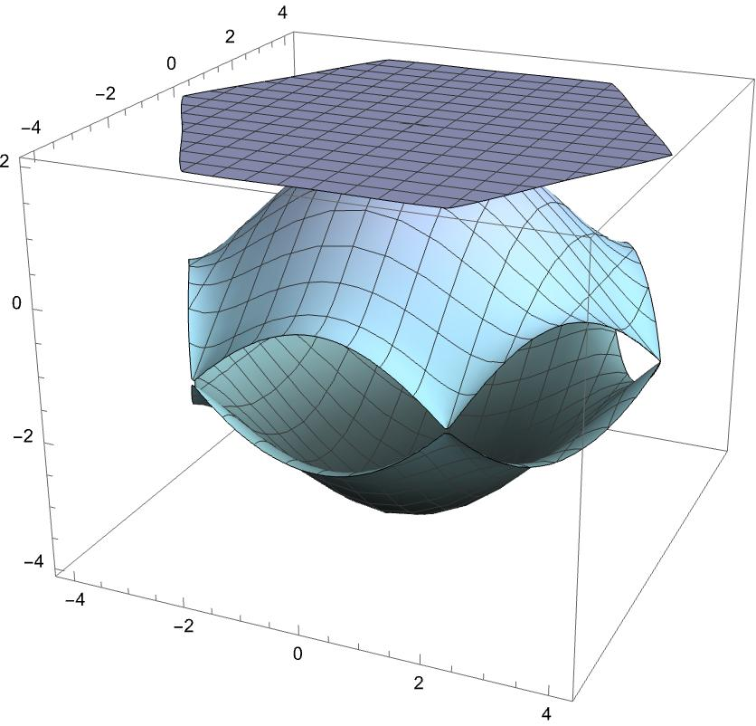



Interplay of Higher-Order van Hove Singularities and Band Topology in Kagome Systems
Edrick Wang, Lakshmi Pullasseri, Luiz Santos
Department of Physics, Emory University, Atlanta, GA 30322
Motivation
Specific Aim
Methods (continued)
In the past few decades, 2D materials have attracted much interest in the field of condensed matter field due to their exotic properties.
The Kagome lattice (Fig. 1) is of particular interest because of its flat band, which enhances strongly-correlated electron-electron interactions, and its lattice geometry, which can spontaneously produce frustration among the electrons.
We wish to investigate the Kagome lattice using the tight binding model, considering Nearest-Neighbor and Next-Nearest-Neighbor hopping. We determine the parameters at which HOVHS emerge for the high-symmetry points in the 1st Brillouin Zone. We also find the regions in the parameter space where topologically non-trivial Chern bands emerge.
2. Chern Number
Chern numbers ($υ$) refer to the topological invariant that is associated with the Quantum Hall Effect^{1.}
Chern numbers can only be integers and correspond to how many quantized charges are produced at the edge of the bulk material.
Our goal is to find the regions in the parameter space where any of the three bands have a non-trivial Chern number (i.e. $υ≠0$).
Chern numbers can be found by integrating the Berry curvature (equivalent to a magnetic field) over the 1st Brillouin Zone.
All three bands can have a non-trivial Chern number and become a Chern band.
Model
Methods
The tight binding model is a good approximation and can provide valuable insights to how the bulk material behaves.
In our model, we will consider a real Nearest-Neighbor (NN) Hopping term, and a complex Next-Nearest-Neighbor (NNN) Hopping term.
The hopping strength for NN- and NNN-hopping are $t_{1}$ and $t_{2}e^{±iφ}$, respectively. The sign for the complex phase depends on the direction of hopping (see Fig.1).
The real lattice vectors are ${\vec{a}}_{1}=a \left(1,0\right)$, ${\vec{a}}_{2}=\frac{a}{2} (1,\sqrt{3})$, and ${\vec{a}}_{3}=\frac{a}{2} (1,−\sqrt{3})$, where a is the lattice constant and is set to $a=1$. These vectors connect the unit cells, which consist of site a, b, and c.
The Hamiltonian for NN-Hopping is
$$H_{NN} =−t_{1}\left(\begin{matrix}0 & 1+e^{−i\vec{k}∙{\vec{a}}_{2}} & 1+e^{+i\vec{k}∙{\vec{a}}_{3}} \\ 1+e^{+i\vec{k}∙{\vec{a}}_{2}} & 0 & 1+e^{+i\vec{k}∙{\vec{a}}_{1}} \\ 1+e^{−i\vec{k}∙{\vec{a}}_{3}} & 1+e^{−i\vec{k}∙{\vec{a}}_{1}} & 0\end{matrix}\right)$$
Similarly, the Hamiltonian for NNN-Hopping is
$$H_{NNN} =−t_{2}\left(\begin{matrix}0 & e^{+iφ}(e^{+\vec{k}∙{\vec{a}}_{1}}+e^{−\vec{k}∙{\vec{a}}_{3}}) & e^{−iφ}(e^{−\vec{k}∙{\vec{a}}_{1}}+e^{+\vec{k}∙{\vec{a}}_{2}}) \\ e^{−iφ}(e^{−\vec{k}∙{\vec{a}}_{1}}+e^{+\vec{k}∙{\vec{a}}_{3}}) & 0 & e^{+iφ}(e^{−\vec{k}∙{\vec{a}}_{2}}+e^{−\vec{k}∙{\vec{a}}_{3}}) \\ e^{+iφ}(e^{\vec{k}∙{\vec{a}}_{1}}+e^{−\vec{k}∙{\vec{a}}_{2}}) & e^{−iφ}(e^{\vec{k}∙{\vec{a}}_{2}}+e^{\vec{k}∙{\vec{a}}_{3}}) & 0\end{matrix}\right)$$
The total Hamiltonian is, then,
$H_{Total} =H_{NN}$+ $H_{NNN}$
We then diagonalize the Hamiltonian and obtain the three energy bands, as a function of $kx, ky, t_{2},$ and $φ$. Throughout the analysis, $t_{1}$ is set to $t_{1}=1$ as the unit energy.
1. Higher-order van Hove Singularities
(Ordinary) van Hove Singularities (VHS) are points on the energy bands where the density of states of the electrons diverge in a logarithmic relation.
In 2D materials, VHS corresponds to a saddle point on the energy band.
Higher-order VHS (HOVHS) give a power law divergence! This means HOVHS enhances even stronger electron-electron interaction.
In 2D materials, HOVHS correspond to a higher-order saddle point on the energy band, where its Hessian, defined as
$ℍ_{n,k}\text{ = }\text{det}\text{( }\frac{{\text{∂}}^{2}{\text{ε}}_{n,k}}{{\text{∂}\text{k}}_{i}{\text{∂}\text{k}}_{j}}\text{)}$,
vanishes to 0.
We want to find at what parameter values will give a Hessian value of 0 at a given point on the energy bands.
All high-symmetry points (i.e. $Γ$, $±K$, and $M_{i}$, i=1,2,3) are analyzed for the emergence of HOVHS.
Fig 4. Chern number phase diagrams in the $t_{2}−φ$ parameter space for the three bands. The z-axis indicates the Chern number of the band.
Realizing the Model
The Kagome optical lattice has been realized².
The Haldane model, which contains a complex NNN-hopping term in the Hamiltonian and has a similar hexagonal geometry as Kagome, has been realized³.
The topology of the bands can be probed using differential drift³.
Fig 5. Optical lattice utilizes standing light waves to create potentials, as shown in the figure (figure taken from [2])
Future Steps
Consider other similar model Hamiltonians for Kagome lattices and determine the necessary conditions to host HOVHS.
Include interaction terms in the Hamiltonian and elucidate their effects on the current model.
Fig 3. Phase diagrams in the ${φ−t}_{2}$ parameter space for band 1, 2, and 3. the boundaries correspond to when HOVHS emerge at one of the three types of high-symmetry point.
References
Fig 1. The Lattice model of the Kagome Lattice
Fig 2. Band structure of the Kagome lattice
Only the region $φ=[0,π]$ is plotted, since Hessian is invariant under $φ→2π−φ$⁴.
As seen from Fig. 3, all three bands are able to host HOVHS at all high-symmetry points.
[1] Klaus von Klitzing. The quantized Hall effect. https://link.aps.org/doi/10.1103/RevModPhys.58.519
[2] Gyu-Boong Jo et al. Ultracold Atoms in a Tunable Optical Kagome Lattice. https://link.aps.org/doi/10.1103/PhysRevLett.108.045305
[3] Gregor Jotzu et al. Experimental realization of the topological Haldane model with ultracold fermions. http://doi.org/10.1038/nature13915
[4] Pedro Castro et al. Emergence of Chern Supermetal and Pair-Density Wave through Higher-Order Van Hove Singularities in the Haldane-Hubbard Model. https://doi-org.proxy.library.emory.edu/10.1103/PhysRevLett.131.026601

